Slide 1
Gradometer Notes

Slide 2
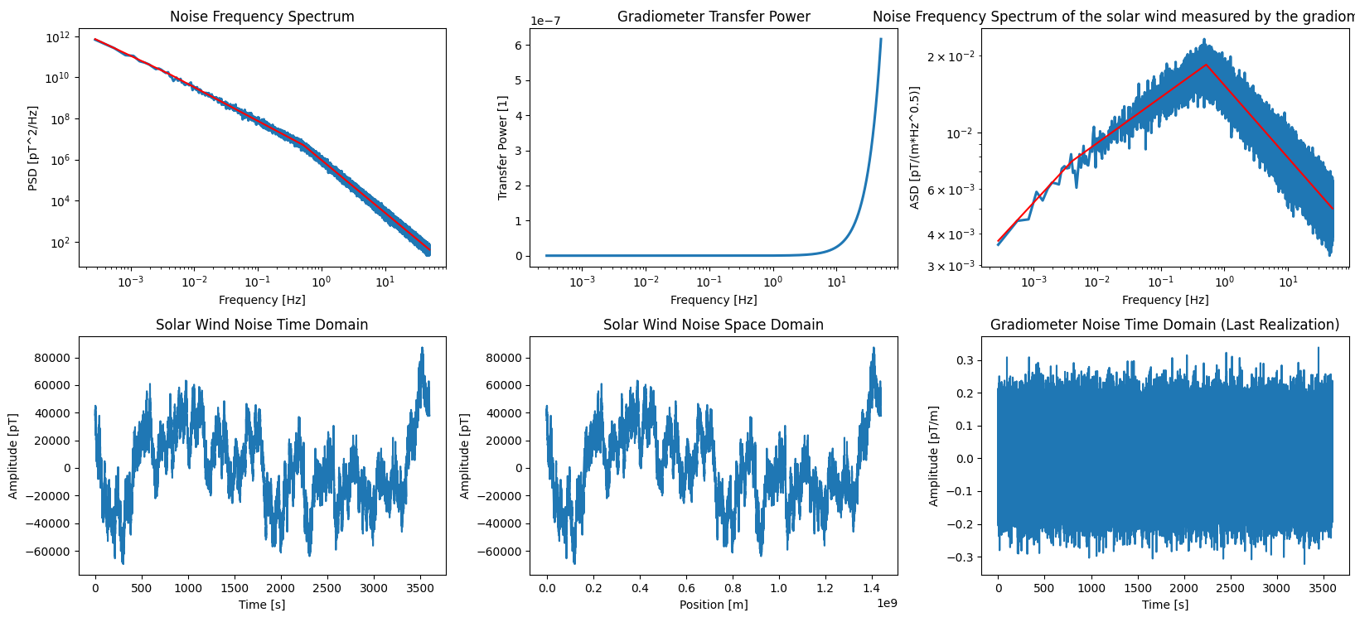
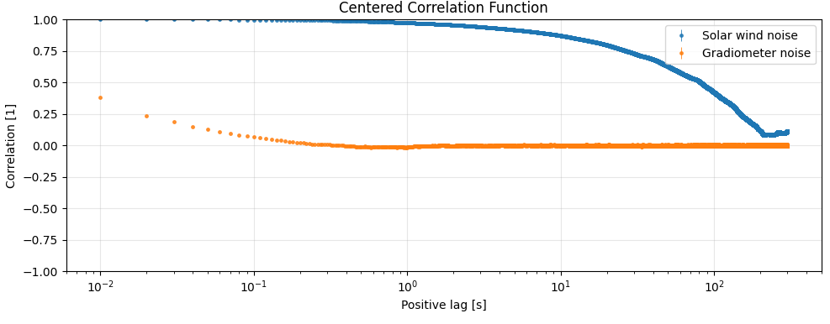
10 m Gradiometer

Slide 3
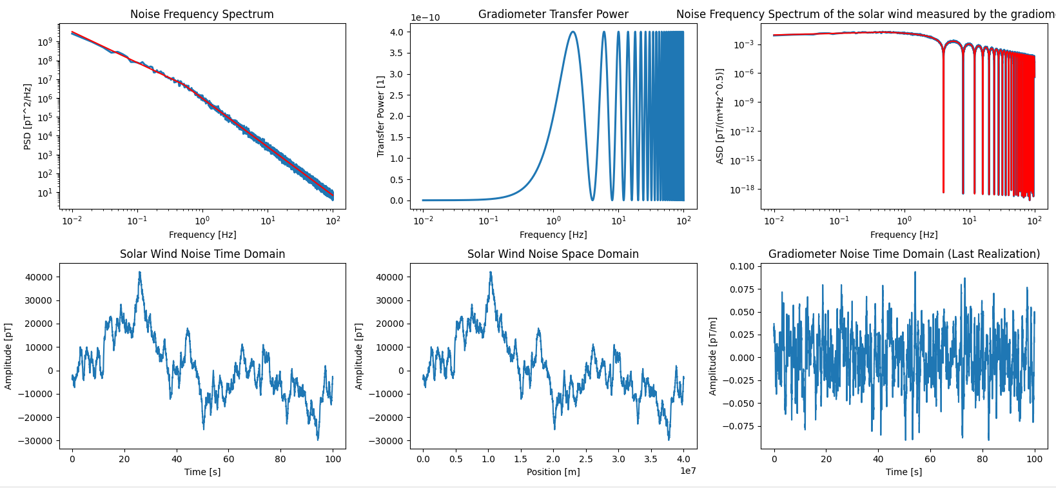
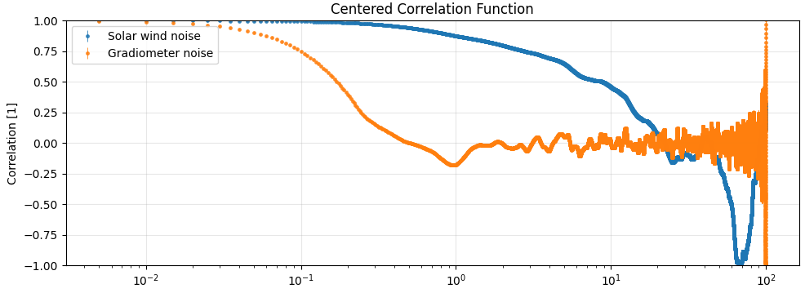
100 km Gradiometer

Slide 4
Conclusions
Samples of more than 1 second are well into the uncorrelated regime for 10 m and 100 km designs of gradiomenter
However, without the gradiometer the solar wind is correlated upto 100 s
I’m not exactly sure why the two calculations of correlation of the (blue) solar wind only differ so much. It is likely because correlation is not well defined for a power law so difference in sample window greatly affect the result.

Slide 5

Why this is true (tight version)
If the noise PSD is
$S\left(f\right)=\frac{A}{f},$
and your frequency bin scales as
$Δf∼f \left(\text{constant} \text{fractional} \text{bandwidth}\right),$
then the noise power in that bin is
$σ^{2}\left(f\right)∼S\left(f\right) Δf∼\frac{A}{f} f=A.$
So:
Lower frequencies → higher PSD
But → proportionally narrower bandwidth
They cancel
That’s exactly the reasoning you gave.
This is why people say:
$1/f$noise has equal power per decade

Slide 6
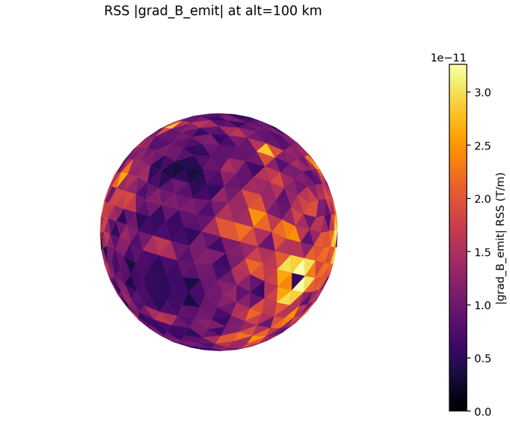
Peak Gradient are about 20 pT for large conctivity variation
RMS conductivity 5%
Peak 30 pT/m

